Slide 1
Grand Tours, Projection Pursuit Guided Tours, and Manual Controls
Weber YC, Huang
Data Science Institution, TMU

Slide 2
Summary
It’s a chapter about Multivariate Statistical Analysis (多變量分析) with Data Visualization, using the application, GGobis, which is an open source visualization program for exploring high-dimensional data. (Noted that it can be use in R through package “rggobis”, see ggobis).
In this chapter, the method of how to perform high dimension variables in a low dimension screen is discussed.

Slide 3
Contents
1. Introduction
2. Tours
3. Using Tours with numerical methods
4. End notes

Slide 4
1. Introduction
Finding structure in multidimensional data when screen are only 2D?

Slide 5
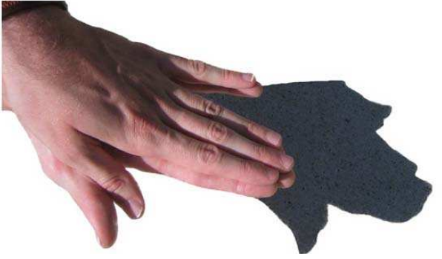
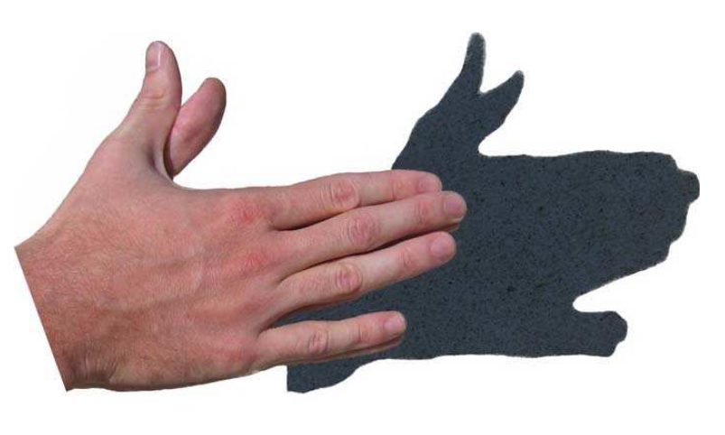
What is projection ? (1/2)

Slide 6
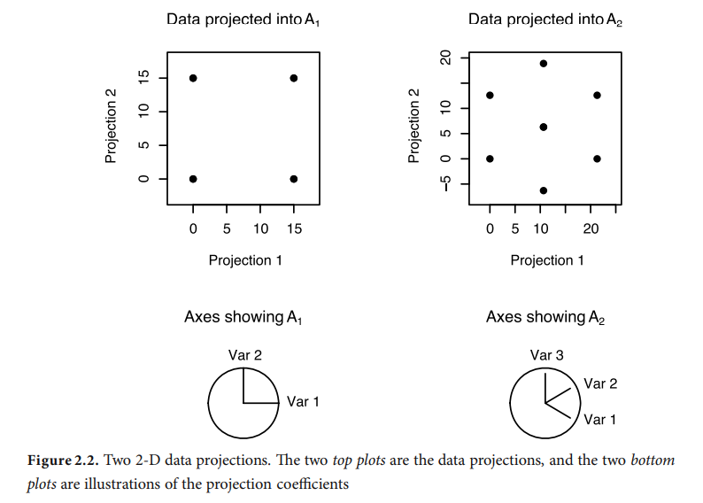
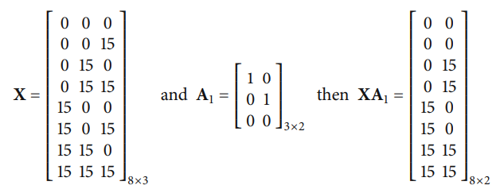
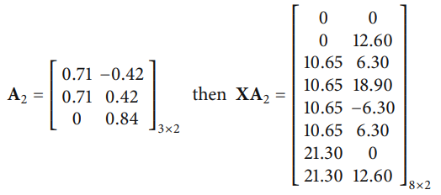
What is projection ? (2/2)
Mathematically, a projection of data is computed by multiplying an n x p data matrix (Dot Product)

Slide 7

The blind men and the elephant
Multi D -> 2D
Fisher linear discrimination ??
PP ??
PCA ??

Slide 8
Interpolation methods
As they are commonly called as “tours”:
Tours in GGobi :
Grand tour
PP guide tour
Manual control
When we use tours, what are we looking for in the data? We search for data projections that are not bell-shaped and, hence, not normally distributed, for example, clusters of points, outliers, nonlinear relationships, and low-dimensional substructures.

Slide 9
2. Tours
Grand tour
PP guide tour
Manual control

Slide 10
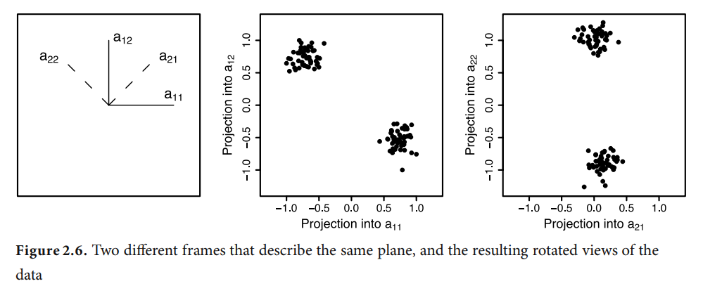
Movement of projection plane
Views of p-dimensional data can be computed in analogous ways
Rotating the entire p-dimensional data
Moving a d(< p)-dimensional plane through the space and projecting the data onto it.

Slide 11
Selecting the target plane
Grand tour uses a random selection of target plane.
Guided tour quantifies the structure present in each projection and uses this to guide the choice of target plane.
Manual controls let the user choose the target direction by manipulating the values of projection coefficients.

Slide 12
Grand Tour (1/2)
The grand tour method for choosing the target plane is to use random selection. A frame is randomly selected from the space of all possible projections.
A target frame is chosen randomly by standardizing a random vector from a standard multivariate normal distribution: sample p values from a standard univariate normal distribution, resulting in a sample from a standard multivariate normal. Standardizing this vector to have length equal to one gives a random value from a (p-1)-dimensional sphere, that is, a randomly generated projection vector. Do this twice to get a 2-D projection, where the second vector is orthonormalized on the first.

Slide 13
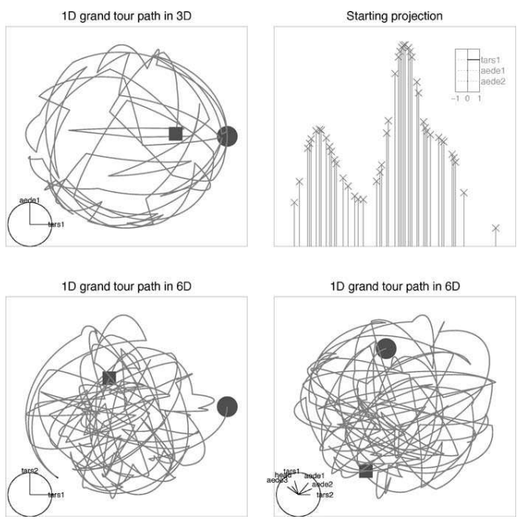
Grand Tour (2/2)

Slide 14
Projection Pursuit Guided Tour
In a guided, the next target basis is selected by optimizing a PP index function. The index function numerically describes what is interesting in a projection: higher values correspond to more interesting structure in the projections.
Using a PP index function to navigate the high-dimensional data space has the advantage over the grand tour of increasing the proportion of interesting projections visited.
The optimization procedure is an important part of a PP guided tour. he purpose of PP optimization is to find all of the interesting projections, so an optimization procedure needs to be flexible enough to find global and local maxima. It should not doggedly search for a global maximum, but it should spend some time visiting local maxima.

Slide 16
3. Using Tours with numerical methods

Slide 18
4. End notes

